Slide 1


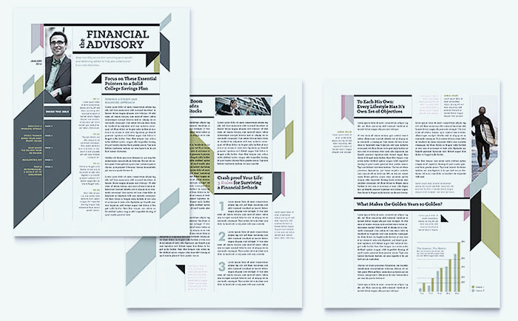

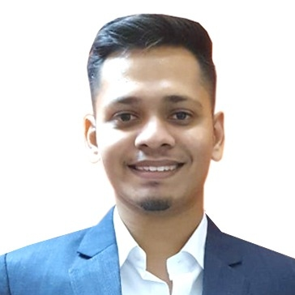

Finshots Idea Lab Season 1 2024
Empowering Financial Growth: Real-Life Success Stories Across Multimedia Platforms
The Philosopher’s Stone, IIM Shillong
Team
Eshaan Arora
Mayank Sharma
Purvi Mandot

Slide 2

















Overview of Finshots: Mission and Key Differentiators
Financial News Made Simple
Finshots is a 3-minute daily newsletter which uses storytelling as their secret sauce
Key Performance Metrics
500K+
1.5M+
3-Min Read
80%+
10%+
Social Media Presence
Subscribers to the Finshots newsletter
Social Media Followers across platforms
for each newsletter, offering quick financial insights
Average Open Rate for the Finshots newsletter
Share Rate for
Finshots newsletters
Highlighting Finshots' Reach and Engagement
Unique Value Proposition of Finshots
Target Audience Insights
Funding and Support
Jargon Free Content
Finshots avoids complicated financial terminology, ensuring that even those without a finance background can easily grasp
Gen Z and Millennials
Aimed at individuals in their early 20s to mid-30s
Digital Natives
Engages audiences through online platforms
Early Career Professionals
Focused on providing financial insights to those starting their careers
Limited Financial Background
Tailored to readers without formal financial education
Time-Conscious Individuals
Offers quick, 3-minute reads that fit into busy schedules
Backed by
Zerodha’s reputation elevates Finshots' market visibility
Actionable Insights
Each newsletter goes beyond just news, providing readers with actionable financial advice they can apply in their personal and professional lives
Zerodha ensures Finshots’ financial growth stability
Zerodha opens collaboration opportunities for Finshots
Co-branded Financial Webinars, Advanced finance insights for Zerodha’s Clients, Referral Programs, & Financial Literacy Workshops
Visual Aids and Graphics
Finshots uses infographics, charts, and visual elements to break down complex data, making the information more digestible and engaging
Zerodha’s support helps Finshots scale efficiently
Content Distribution Channel
Founding Partners
Consistent Publishing Schedule
The daily newsletter ensures readers are kept consistently informed without overwhelming them
E-mail Newsletter
Mobile Application
Multimedia Approach
Finshots reaches its audience through diverse formats, including email newsletters, podcasts, videos, social media carousels, and infographics, catering to different learning preferences
Spotify Podcasts and other Apps
Infographics and Carousels

Slide 3




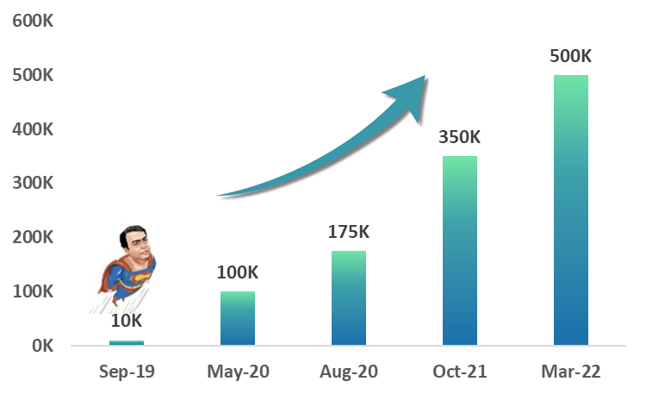




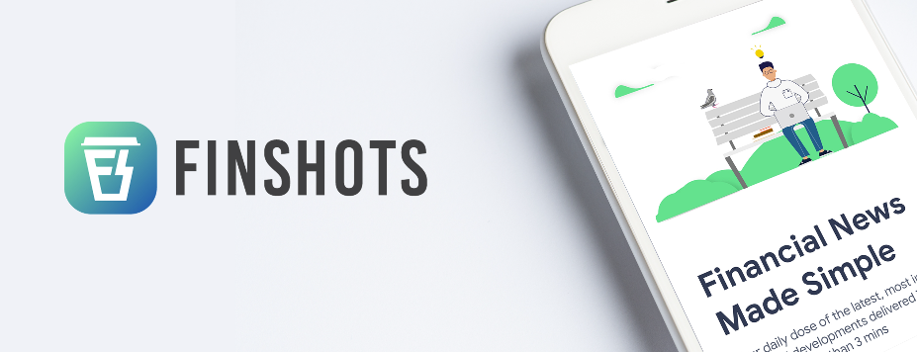
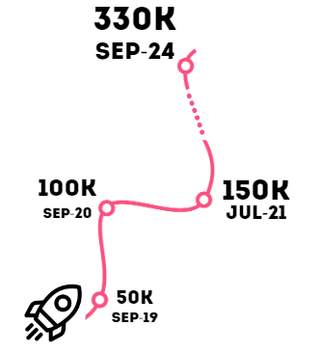

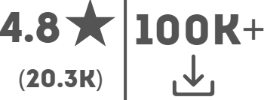

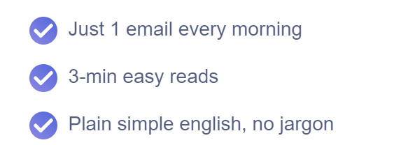









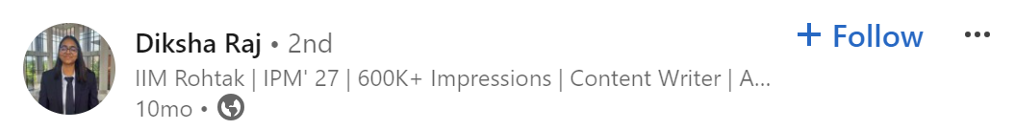
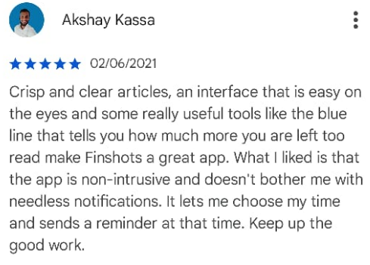

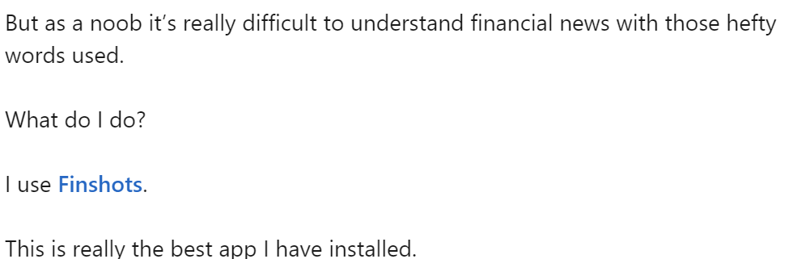
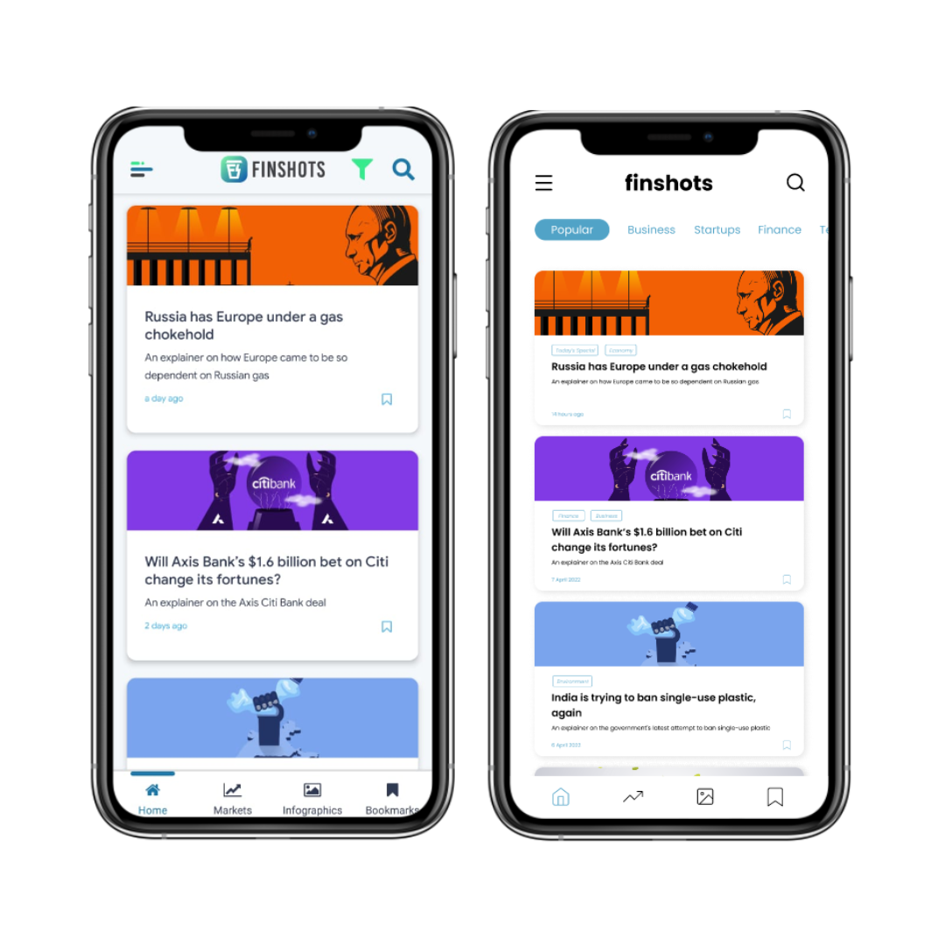

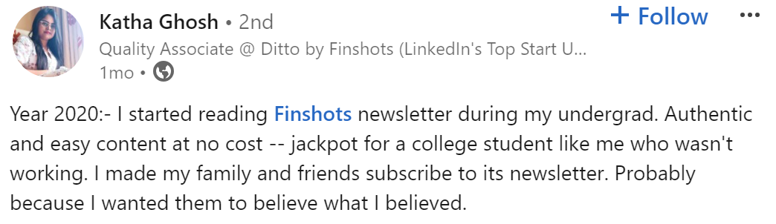
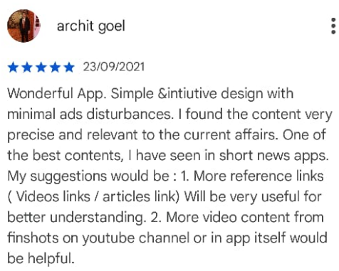

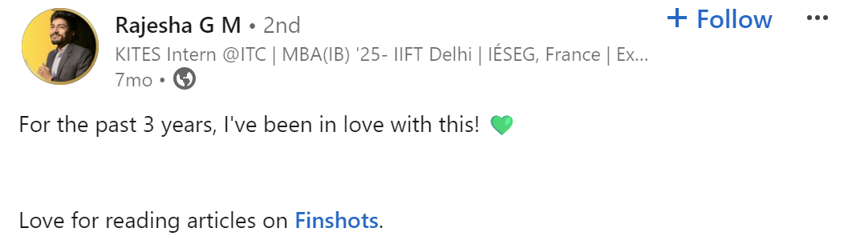



Current Engagement Strategies and Performance Metrics
Money Resolutions
Personal Finance
New Year’s Financial Goals
Actionable Advice
Budgeting calculators and progress trackers
Money Milestones
Life Event Planning
Retirement and Tax Planning
Comparison Insights
Personal Anecdotes and Practical Tips
Calculators and trackers drove active reader participation
Relevant topics encouraged sharing and social visibility
High-quality content led to stronger retention rates
Relatable advice increased loyalty and engagement
Increased Customer
Engagement
9 January 2022
Started in
@finshots.in
@finshotstv
Finshots Daily
Newsletter Subscriber Growth
Feedback and Testimonials
Multichannel Approach driving newsletter engagement
Call-to-Action Links
UI/UX Design
Podcast Episodes
Consistent
Visual Identity
Clean, Minimalist Interface
on YouTube
Seamless
user-experience
Quick Load Times
Infographic Previews
On Social Media
Testimonials

Slide 4


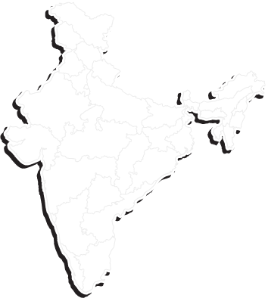











Market Research and Competitive Landscape
Global News & Magazines Market
Indian News & Magazines Market Outlook
$274.8 mn
Major Growth Drivers
Personalized Content
AI-driven customized
news feeds
Government Initiative
$ 11.11 bn
Increased digital content consumption
Rising in-app purchase revenue
Total Market Size (E)
in 2023
Growing advertising-driven models
Smartphone Penetration
Exceeding 50% by 2025
Internet Expansion
Boosted by 5G rollout
Total Revenue
in 2023
$ 20.74 bn
137.4
mn
9.96%
Metric | Value
Total Smartphone Users (India) | 687 million (2023)
Percentage Using News Apps | 20% of smartphone users
Average Revenue Per User (ARPU) | $2 annually (estimated)
Annual growth rate
(CAGR 2022-2029)
Expected Revenue by 2029
Potential User Base
Assumptions
Source: Statista Market Insights
Competitive Landscape
Competitive Moat of
Competitor
Strength
Weakness
Opportunity
Threat
Premium financial
content
Expert-driven analysis
Higher subscription
costs
Niche target audience
Expand content
categories
Increase market
penetration
Growing free
alternatives
Increasing competition
pressure
Strong Brand Credibility
Backed by Trusted Financial Partner
User-friendly platform
Strong financial
education
Expand premium
offerings
Enter global markets
Intense competition
Growth
Regulatory financial
changes
Simplified Content Strategy
Engages readers with jargon-free language
Limited advanced tools
Reliant on beginners
Overwhelming interface complexity
Premium content
restrictions
Expand mobile app
features
Monetize through
personalized content
Diversified Content Channels
Reaches audience via multiple platforms
Extensive financial
coverage
Trusted industry
brand
Increasing competition presence
Rise of free platforms
High Quality Infographics
Visually appealing, enhances content
understanding
Comprehensive finance
courses
Simplified investment
tools
Limited brand
recognition
Niche audience focus
Expand content variety
Collaborate with
financial institutions
Growing competitor
platforms
Regulatory changes
affecting finance
Multi-format Content Delivery
Email, podcasts, social media, videos

Slide 5






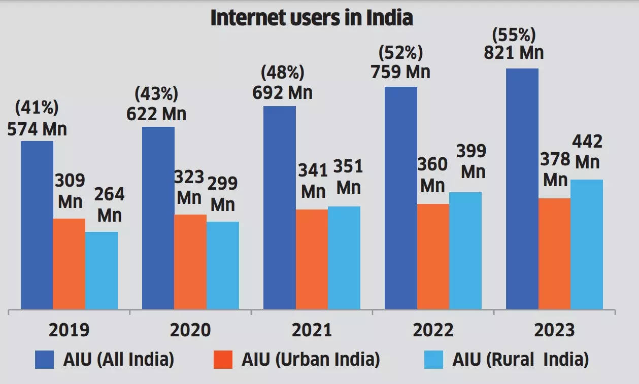



Proposed Initiative – "Real-Life Financial Success Stories" Podcast Series
Podcast Concept
Cross-Platform Strategy
Target Audience
Launch a YouTube and podcast series featuring real-life financial success stories, hosted by a Finshots team member interviewing individuals who’ve achieved financial success
Blog Summaries
Concise articles summarizing each podcast episode
Key Takeaways
Highlight actionable financial tips from success stories
SEO Optimized
Improve search visibility with relevant keywords
Reader-Friendly Format
Simplified language for easy understanding
Cross-Platform Promotion
Drive podcast traffic through blog links
Urban and Semi-Urban Population
Young Professionals
(Ages 20-35)
& other platforms
75% of Gen Z and Millennials want to improve their financial literacy
69% of urban Indian users consume financial content online
(KPMG, 2021)
Students and
Recent Graduates
Low to Middle-Income Groups
Each episode will focus on one person’s journey, breaking down their financial strategies, challenges, and key decisions that led to success
27% of Indian students receive financial
education at school
(OECD, 2019)
Only 24% of Indians are financially literate
(SEBI, 2020)
Strategic Rationale
Expected Impact
Rising demand for engaging, multimedia financial content.
Personal stories foster emotional connection with listeners.
Relatable success stories inspire actionable financial decisions.
Podcasts cater to time-constrained, on-the-go audiences.
Video and audio OTT consumption is the top way Indians are using the internet
Multimedia Reach
Increased Loyalty
Viral Potential
Distributing content on YouTube, podcasts, and blogs expands reach and appeals to diverse audiences
Consistent delivery of success stories builds trust, encouraging long-term loyalty among Finshots subscribers
Relatable financial success stories have high shareability, driving organic growth through social media platforms
India was the country with the largest YouTube audience by far, with approximately 476 million users engaging with the popular social video platform
Sources: Business Standard, ET Money, IIMA Research Paper

Slide 6





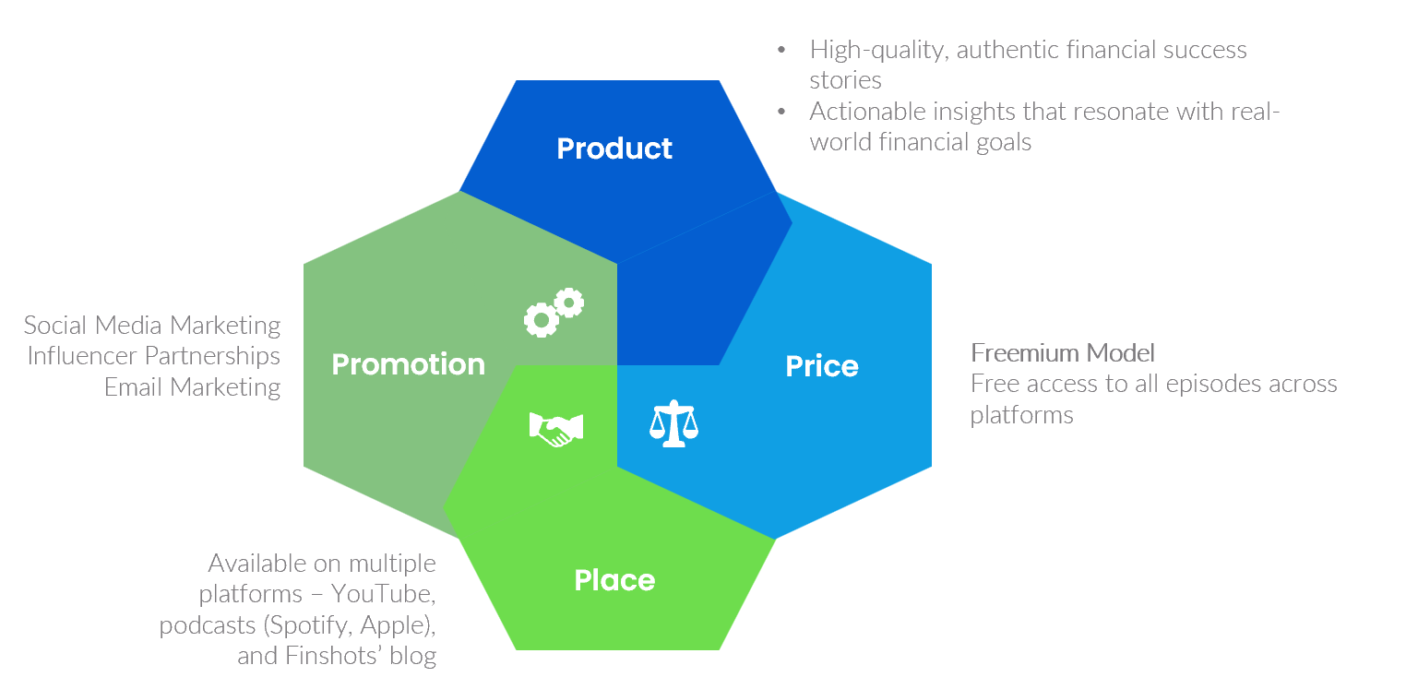
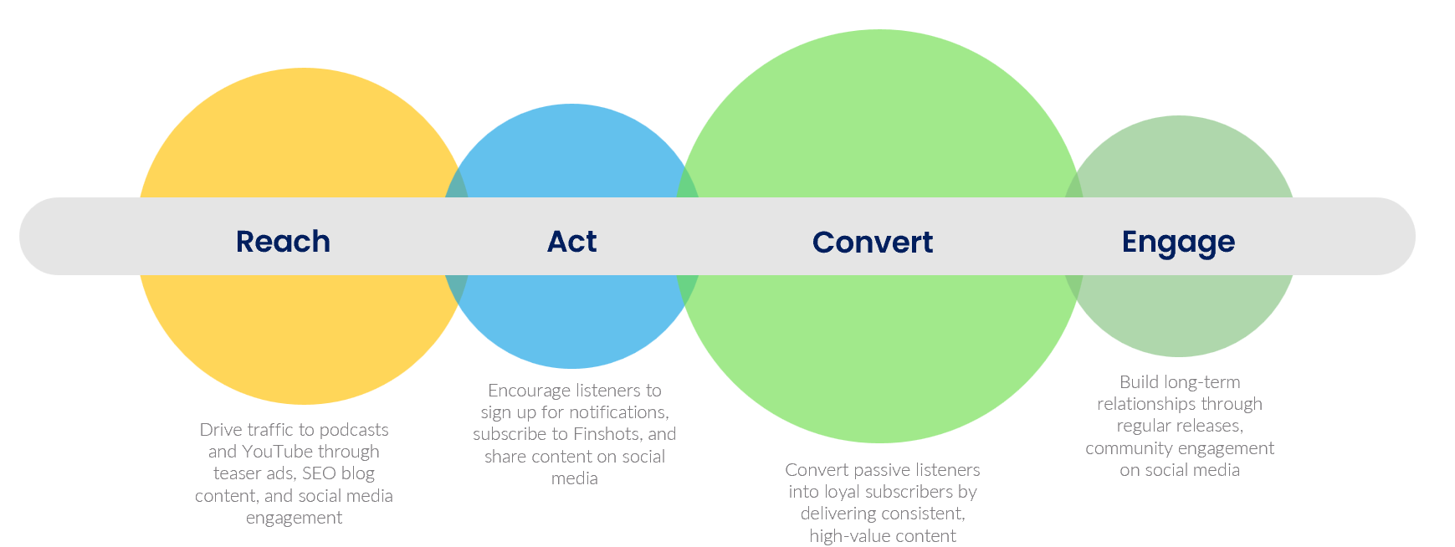
Implementation Roadmap and Marketing Strategy
Implementation Roadmap
Content Creation (Month 1-2)
Identify diverse success stories from various demographics
Develop scripts focused on key financial insights
Record interviews with professional host in studio
Platform Launch (Month 4)
"Real-Life Financial Success Stories" series on YouTube and popular podcast apps
Publish blog summaries on the Finshots website with SEO-optimized keywords to drive traffic
Content Consistency
(Month 6+)
Production (Month 3)
Develop content for YouTube, Spotify, Apple Podcasts
Write blogs summarizing financial lessons, success stories
Execute platform launch with impactful marketing strategies
Audience Feedback (Month 5)
Gather feedback from early listeners via surveys and social media comments
Use insights to refine content style, format, and episode frequency
Marketing Strategy
4P's Framework (Product, Price, Place, Promotion)
RACE Framework

Slide 7
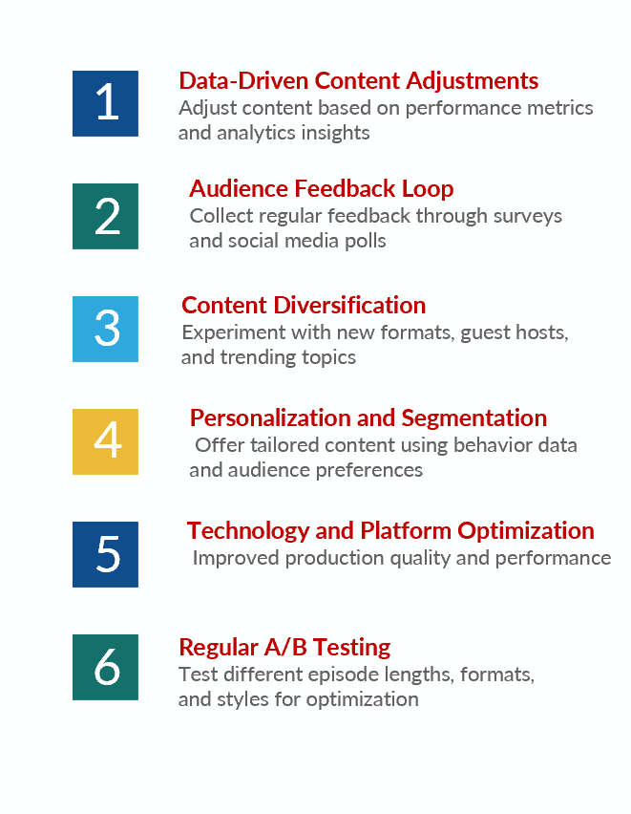
Success Metrics and Continuous Improvement
Success Metrics
Continuous Improvement
1
Engagement Rates
Track listener/viewer engagementUse analytics from platforms like YouTube, Spotify, and Google Analytics to measure content performance
70%+
60%
Benchmark
Completion rate for
podcasts and videos
Open rates for blogs
2
Subscriber Growth
Measure growth in new subscribers across platforms (YouTube, podcast apps, blog subscribers)
Track monthly and quarterly growth rates to assess the effectiveness of content and marketing campaigns
Benchmark
10%
monthly increase in subscribers after launch
3
Social Media Engagement
Monitor likes, shares, comments, and retweets of podcast/video content across social media platforms
Assess the virality of episodes by tracking hashtag usage, mentions, and social shares
Benchmark
5%
Increase in engagement rate monthly
on social platforms and consistent growth
4
Referral Traffic and
Conversion
Analyze traffic driven from podcasts and YouTube to the Finshots website and blog
Measure conversion rates from viewers/listeners to blog readers and email subscribers
Continuously refine content and strategy using data-driven insights, audience feedback, and technological advancements for sustained engagement and growth
Benchmark
15-20%
Conversion rate from podcast listeners to blog subscribers

Slide 8
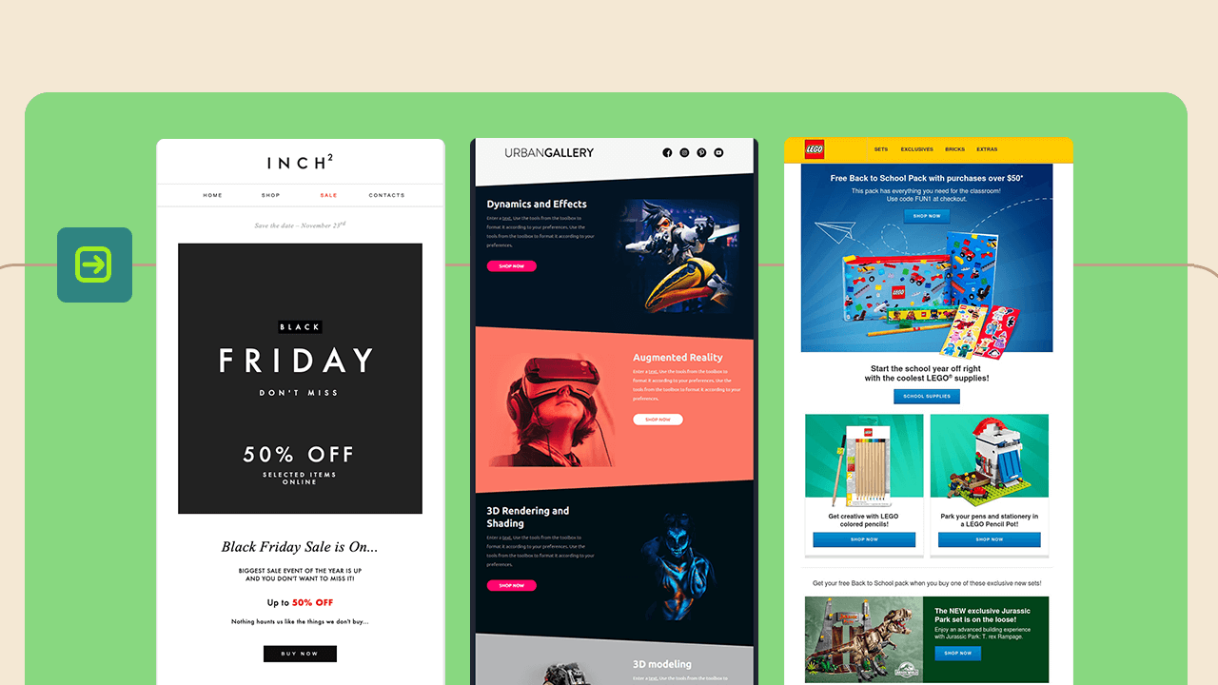
Thank You

